Slide 1
SPARQL QUERY in BIO2RDF
Big Data in Medical Informatics

Slide 2
BIO2RDF Project
BIO2RDF is an open source framework that makes biological data available on the emerging semantic web using a set of simple conventions.
10 billion triples
29 datasets:
http://download.bio2rdf.org/release/3/release.html
The datasets include interlinked data on genes, proteins, biological models, drugs, gene/protein interactions, genomics, literature etc.
SPARQL 1.1 endpoints using Virtuoso 7.1.0 or Yasgui
http://bio2rdf.org/sparql
http://legacy.yasgui.org/

Slide 3
Finding basic drug information
Find all drugs from the DrugBank dataset along with disease indication information
Prefix Declarations: Shortcuts for URIs used in the query (e.g. rdf, rdfs, bio2rdf)
PREFIX rdfs: <http://www.w3.org/2000/01/rdf-schema#>
PREFIX db: <http://bio2rdf.org/drugbank_vocabulary:>
DrugBank Dataset: http://download.bio2rdf.org/release/3/drugbank/drugbank.html
Notes:
URI = Universal Resource Identifier
Namespace is a specific name used for a particular purpose. In this case, we name namespaces with URI.
In our specific case, we are interested for RDF schema and dugbank vocabularies.
Also, in the figure you can find the triple architecture for this specific case.

Slide 4
Finding basic drug information
Find all drugs from the DrugBank dataset along with disease indication information
Result Clause: Data returned by the query
SELECT ?drug_name ?indication
DrugBank Dataset: http://download.bio2rdf.org/release/3/drugbank/drugbank.html
Notes:
SELECT returns table of variables that satisfy the query. In our case, there will be 2 variables returned, meaning a table of 2 columns. The first column will display the drug names and the second one will display its indication.

Slide 5
Finding basic drug information
Find all drugs from the DrugBank dataset along with disease indication information
Query Pattern: Graph Pattern used to search the RDF data
WHERE {
?drug a db:Drug .
?drug rdfs:label ?drug_name .
?drug db:indication ?indication .
}
DrugBank Dataset: http://download.bio2rdf.org/release/3/drugbank/drugbank.html
Notes:
Query Pattern is supported by WHERE clause. We declare that variable ?drug is an instance of class Drug.
Then we display the label of variable ?drug and call it ?drug_name.
Lastly, using the triple architecture, the query outputs the indication of each specific drug and assings it to a new variable called ?indication.

Slide 6
Finding basic drug information
Find all drugs from the DrugBank dataset along with disease indication information
PREFIX rdfs: <http://www.w3.org/2000/01/rdf-schema#>
PREFIX db: <http://bio2rdf.org/drugbank_vocabulary:>
SELECT ?drug_name ?indication
WHERE {
?drug a db:Drug .
?drug rdfs:label ?drug_name .
?drug db:indication ?indication .
}
DrugBank Dataset: http://download.bio2rdf.org/release/3/drugbank/drugbank.html
Notes:
This is the query till now.

Slide 7
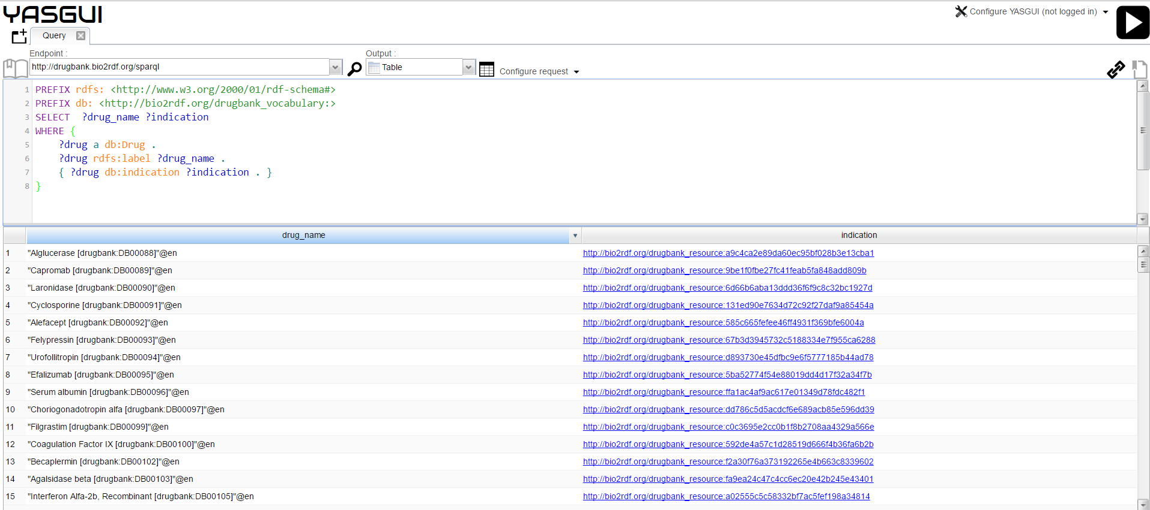

Slide 8
What’s wrong?
Find all drugs from the DrugBank dataset along with disease indication information
PREFIX rdfs: <http://www.w3.org/2000/01/rdf-schema#>
PREFIX db: <http://bio2rdf.org/drugbank_vocabulary:>
SELECT ?drug_name ?indication
WHERE {
?drug a db:Drug .
?drug rdfs:label ?drug_name .
?drug db:indication ?indication .
}
DrugBank Dataset: http://download.bio2rdf.org/release/3/drugbank/drugbank.html
Notes:
Even though it might seem right, there is something wrong with this query.

Slide 9
Aggregate Functions
Aggregates apply expressions over groups of solutions. By default a solution set consists of a single group, containing all solutions.
Grouping may be specified using the GROUP BY syntax, which specifies the key variables to use to partition the solutions into groups.
Common aggregate functions include COUNT, SUM, MIN, MAX, AVG.
SPARQL also includes a HAVING clause to filter the results of the query alter applying aggregates.
In aggregate queries only expressions which have been used as GROUP BY expressions, or aggregated expressions (i.e. expressions where all variables appear inside an aggregate) can be projected.

Slide 10
Find the number of rows
Find all drugs from the DrugBank dataset along with disease indication information
COUNT the number of triples
SELECT ( (?drug_name) as ?amount)
DrugBank Dataset: http://download.bio2rdf.org/release/3/drugbank/drugbank.html
COUNT
The COUNT function is used to output the number of triples containing a given variable
Notes:
To check the number of rows displayed, we can use COUNT keyword.

Slide 11
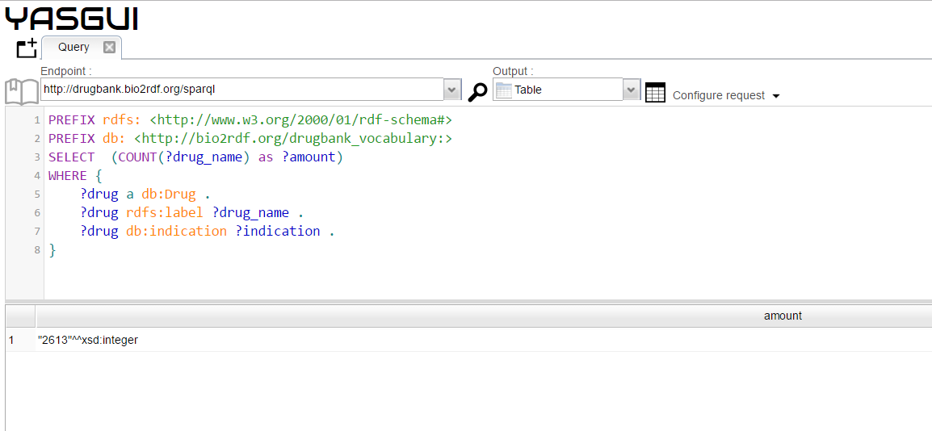
Find the number of rows
Find all drugs from the DrugBank dataset along with disease indication information
Notes:
Our query will output 2613 rows of data.

Slide 12

What’s wrong?
Find all drugs from the DrugBank dataset along with disease indication information
BIO2RDF’s DrugBank dataset has information on about 7759 DRUGS
Trying the query, we only get 2613 rows as shown in the previous slide.
Why? Not every drug has disease indication information!

Slide 13
How to fix it?
Find all drugs from the DrugBank dataset along with disease indication information
OPTIONAL tries to match a graph pattern, but doesn’t fail the whole query if the optional match fails.
If an OPTIONAL pattern fails to match for a particular solution, any variables in that pattern remain unbound (no value) for that solution.
PREFIX rdfs: <http://www.w3.org/2000/01/rdf-schema#>
PREFIX db: <http://bio2rdf.org/drugbank_vocabulary:>
SELECT ?drug_name ?indication
WHERE {
?drug a db:Drug .
?drug rdfs:label ?drug_name .
{?drug db:indication ?indication . }
}
OPTIONAL
Notes:
Optional can be better understand if we create an analogy with left outter join in sql queries. It is similar to it.
It means that OPTIONAL allows the unbound values to be displayed.

Slide 14
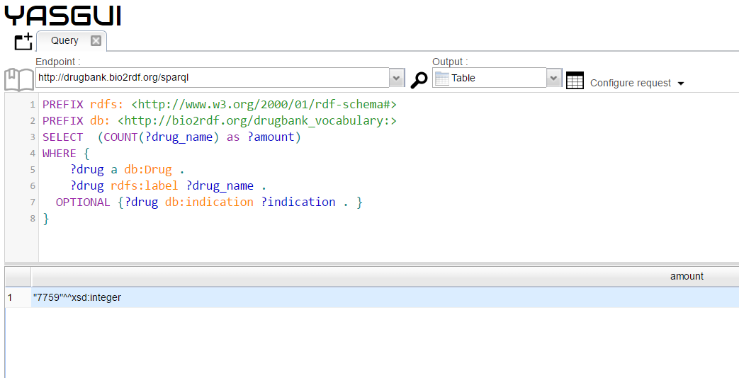
Check the number of triples
Find all drugs from the DrugBank dataset along with disease indication information
Notes:
In this case, there will be 7759 rows displayed.

Slide 15
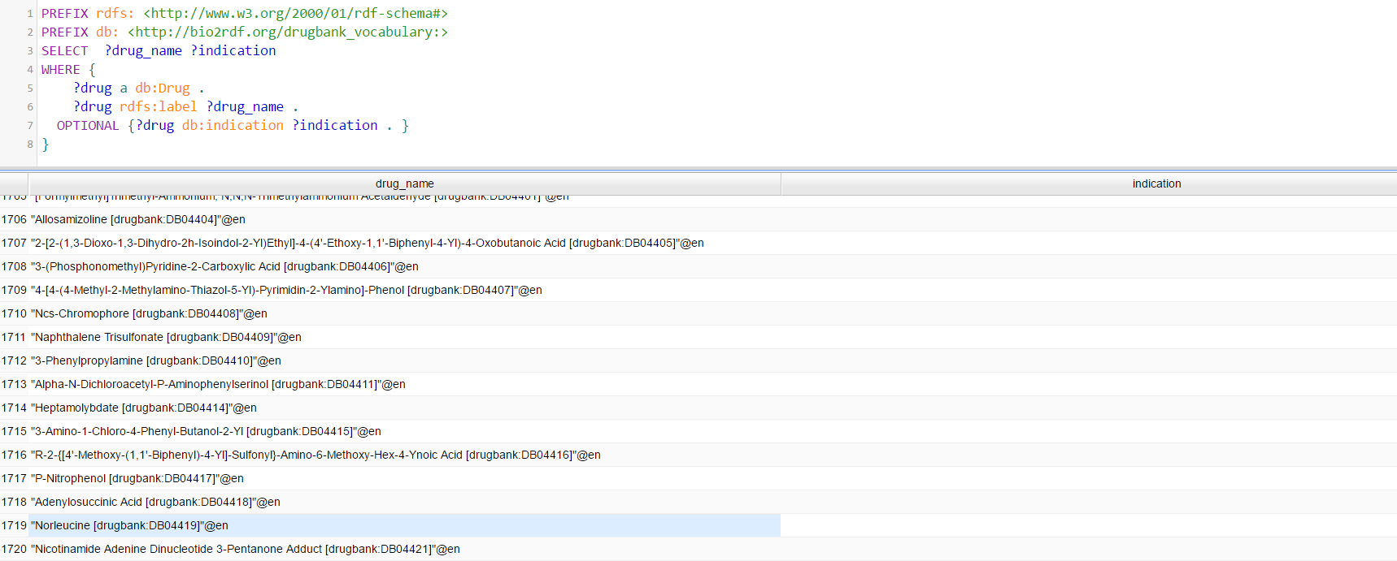
Final Output if disease indication is missing
Find all drugs from the DrugBank dataset along with disease indication information
Notes:
This are some examples of unbound cases which are displayed by the second SPARQL query.

